Slide 1

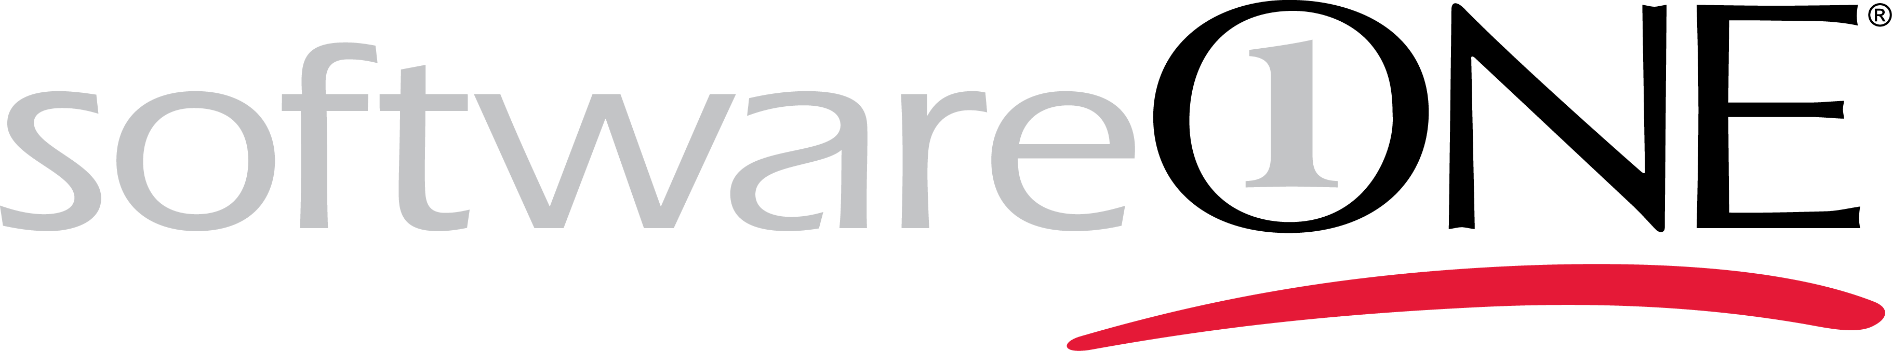
Prerequisite check
Wifi Code
UN: aoguest2105
PW: 671349
Active Azure Subscription & Administrative Access
Visual Studio 2017 (Latest Update)
Azure SDK for Visual Studio 2017 (Latest Update)
Azure Storage Explorer (https://azure.microsoft.com/en-us/features/storage-explorer/)
Software Installation / Code to build / Binaries to deploy
Visual Studio Team Services Account (Optional)
Download the exercise book: https://github.com/henrytruongswo/hackathon/
Azure IaaS Migration Workbook .docx
Notes:
Simply head over to http://portal.azure.com and login

Slide 2
SoftwareONE IaaS on Azure Hackathon

Slide 3
Introduction and Housekeeping Welcome

Slide 4
Meet the team
Who we are and what we do
Henry Truong
Technical Architect

Slide 5
Day 1

Slide 6
Day 1 Agenda
Let’s show you how to build out Azure Infrastructure so you can build a pilot application workload.
Theory:
Azure Background (Regions, Services)
Azure Portal 101
Virtual Networks 101
Storage 101
Compute 101
VM Extensions and Script Execution
Practical: Then let’s take a workload and move it.

Slide 7
Azure Background Regions, Availability, Services

Slide 8
BYODC
IaaS
PaaS
SaaS
Application
Application
Application
Application
Data
Data
Data
Data
Middleware
Middleware
Middleware
Middleware
Operating System
Operating System
Operating System
Operating System
Virtualisation
Virtualisation
Virtualisation
Virtualisation
Storage
Storage
Storage
Storage
Hardware
Hardware
Hardware
Hardware
Networking
Networking
Networking
Networking
Power
Power
Power
Power
Spin up Agility + Operational Efficiency
Legacy Support + Flexibility
Notes:
The classic slide, Build your own DC, vs IaaS vs PaaS vs SaaS.

Slide 9
BYODC
IaaS
Application
Data
Middleware
Operating System
Virtualisation
Azure
Virtualisation
Storage
Storage
Hardware
Hardware
Networking
Networking
Power
Power
Spin up Agility + Operational Efficiency
Legacy Support + Flexibility
Notes:
This session will focus on app migration to IaaS.

Slide 10
BYODC
IaaS
Application
Data
Middleware
Operating System
Virtualisation
Azure
Storage
Hardware
Networking
Power
Spin up Agility + Operational Efficiency
Legacy Support + Flexibility
Notes:
So let’s bring in the crane … and

Slide 11
BYODC
IaaS
Application
Data
Middleware
Operating System
Virtualisation
Azure
Storage
Hardware
Networking
Power
Spin up Agility + Operational Efficiency
Legacy Support + Flexibility
Notes:
Lifting and shifting app, data, middleware, os to azure
In order to do that we need to know what underpins the architecture and how to configure it.

Slide 12
BYODC
IaaS
Application
Data
Middleware
Operating System
Virtualisation
Azure
Storage
Hardware
Networking
Power
Spin up Agility + Operational Efficiency
Legacy Support + Flexibility
Notes:
Lifting and shifting app, data, middleware, os to azure
In order to do that we need to know what underpins the architecture and how to configure it.

Slide 13
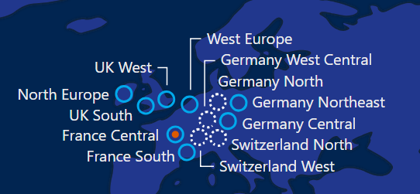
Azure Regions
Azure has 50 regions globally available in over 140 countries. Today we will focus on the European regions.
Main Regions in Europe currently consist of :-
West Europe (Amsterdam)
North Europe (Dublin)
UK South (London)
UK West (Cardiff)
With 4 More DACH Regions coming soon
https://azure.microsoft.com/en-gb/global-infrastructure/regions/

Slide 14
Azure Service Availability per region
Not all services are available in each region, a matrix is available from the below link.
West Europe is the most feature complete
followed by North Europe,
then UK South.
For most IaaS workloads this doesn’t matter, as most of the significant network and storage features are available across the board in Europe, only the compute instances available differ between regions as far as IaaS is concerned.
https://azure.microsoft.com/en-us/regions/services
Notes:
Explain that there are different types and classes of VM instance but we will cover that later on.

Slide 15
Power and Hardware resilience
Azure datacentres are designed to be the most cost and power effective they can possibly be at enormous scale, this results in a design that is optimised to recover quickly from hardware failures, rather than prevent them from ever happening.
Consider your application architecture carefully in terms of service level.
SLA for a single-instance virtual machine, Premium Storage disks only for quick reboots
SLA will exclude maintenance windows
Consider the concepts of fault and update domains within availability sets.
Consider availability zones for future deployments
Zonal / Zone Redundant
2 instances of your (stateless) application w/ load-balancer = SLA goodness
https://azure.microsoft.com/en-us/regions/
Notes:
Explain the concept of Fault and Upgrade domains and explain what an availability set is.
Regions that support Availability Zones
Central US
France Central
East US 2 (Preview)
West Europe (Preview)
Southeast Asia (Preview)
Services that support Availability Zones
Linux Virtual Machines
Windows Virtual Machines
Virtual Machine Scale Sets
Managed Disks
Load Balancer
Public IP address
Zone-redundant storage
SQL Database

Slide 16
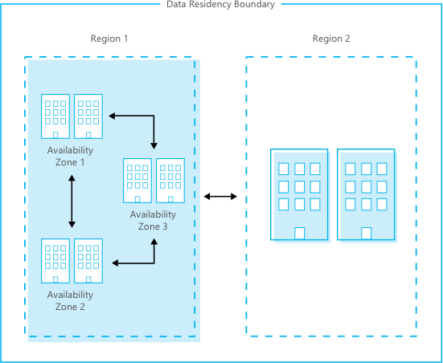
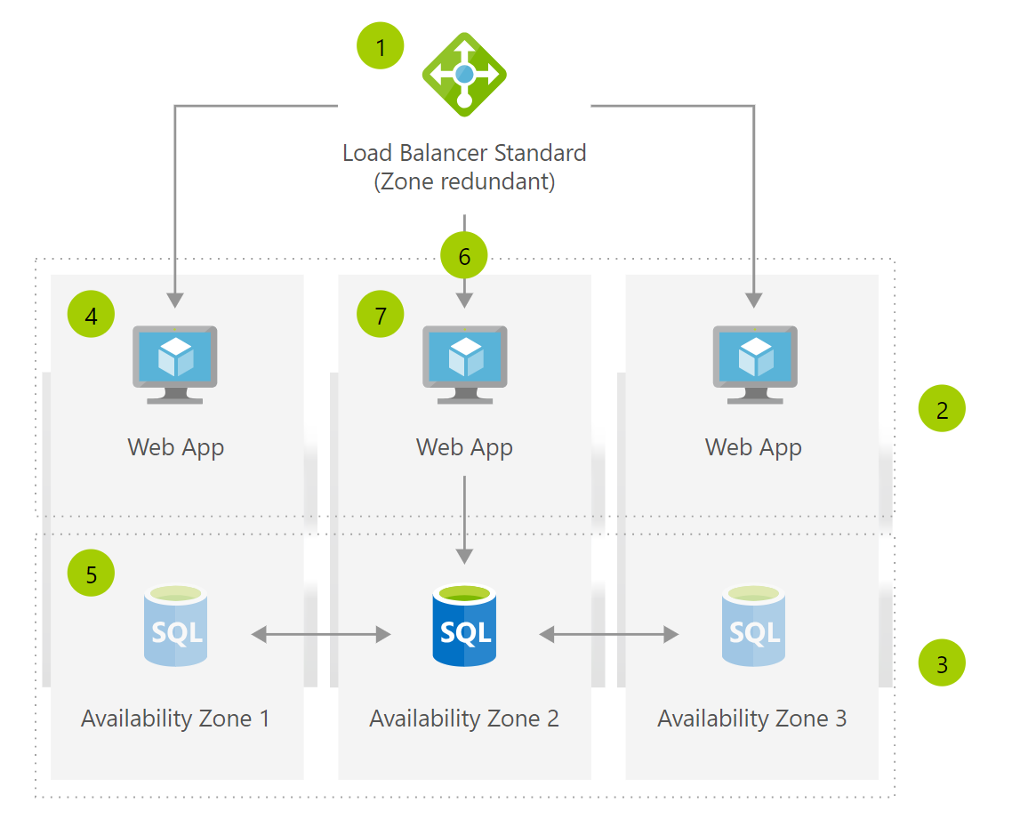
Example architectures

Slide 17
Azure Portal 101 - Identity and logon - Resources and groups - Marketplace - Role Based Access Control
https://portal.azure.com
Notes:
Give a quick run through of the Azure ‘Ibiza’ Portal, ensure everyone can login and access the portal, at least !
Explain the Concept of Resource Groups
Show logged in identity in the portal, mention in-private mode for some azure ad setups is useful if users have multiple identities
-- Mention that you do not want to use ‘Microsoft (Formerly ‘Live’) accounts that have overlapping UPN email claims with Azure AD Accounts and why
-- Explain That Marketplace entries are templated deployments based upon a custom image / resource group template
-- Deploy something quickly from the marketplace
-- Talk to RBAC and permission management of resources against Azure AD.

Slide 18
Azure Portal – Labs pt 1
http://portal.azure.com
Notes:
Simply head over to http://portal.azure.com and login

Slide 19
Virtual Networks 101 - Private Networks - VPNs + ExpressRoute - Network Security Groups (NSG) - Types of IP Addresses - Azure DNS + Traffic Manager - Load Balancers
Notes:
Explain the concept of virtual networks in azure
Explain Private Networking in azure
Explain VPN connectivity
Explain ExpressRoute connectivity
Explain NSGs and show portal config
Explain Load balancers + Internal Load Balancers
Explain and show Azure DNS and Traffic Manager

Slide 20
Connecting your app
Expose an SSL Endpoint
(and unlock it via your Network Security Group)
VNet to VNet Peering
Hybrid Connection Options
Notes:
TCP Bridge / Service Bus Based
A.K.A. BizTalk Hybrid Connections,
Service Bus Relay

Slide 21
Azure Networking – Labs pt 2
Notes:
Break for lab

Slide 22
Storage 101 -Page and Block Blobs/Tiers -Usage patterns: Hot/Cold/Archive -Geo-replication -Temporary ‘scratch’ storage -Premium storage -Azure Disks -Managed/Unmanaged/Caching -Azure File Shares
Notes:
Storage concepts in azure IaaS (Page blobs and vhd hosting)
What does Geo-replication mean, and what are the options and types of storage account?
What are the options for standard Blob storage
What are the options for high-performance IOPS (Premium) storage
What are the caching options
What is the local storage on the D: drive for ? What are it’s characteristics ?
What platform options are provided for hosting Azure Files ?
What platform options are provided for queuing ?

Slide 23
Be aware of the Azure Storage Service Throttles
For unmanaged standard disks…
Bandwidth – max 60MB per VHD
IOPS: Basic A-Series VM – 300 per VHD
IOPS: Standard A-Series, D Series, G Series, F Series VM – 500 per VHD
IOPS: DS Series, GS Series, FS Series VM – Depends on Premium Tier
IOPS: Limit Per-Standard Storage Account - 20,000
Max size of a page blob - 4095GB
Max VHDs per Storage Account: 20,000/500 = 40
Hence limit is 40 approx. standard vhds
https://docs.microsoft.com/en-us/azure/storage/common/storage-scalability-targets
Notes:
So: -
- Stripe VHDs in a software raid set using Storage Spaces
- Or – Use premium storage
200 (250!) max storage acc per region (per subscription)

Slide 24
Azure Storage – Labs pt 3
Mapping the drives requires open ports!

Slide 25
Compute 101 - Stateless vs Stateful workloads - Types of compute (VMs, VM Scalesets) - Images (Gold, Recipe based) - Instance Types
Notes:
Virtual Machine Instances – discuss different types of instance – and use the ready reckoner.
Stateless workloads – put behind a load balancer where possible and load balance as many small instances as you can with auto-scaling
Consider PaaS options here – you should explain the following: {Single instance VM, VM Scale Sets, Batch, Cloud Services, App Service, Functions}.
Mention the impact of VM instance type on boot up speed when creating VMs.

Slide 26



In summary, your VM ready reckoner
General purpose
B, Dsv3, Dv3, DSv2, Dv2, DS, D, Av2, A0-7
Compute optimized
Fsv2, Fs, F
Memory optimized
Esv3, Ev3, M, GS, G, DSv2, DS, Dv2, D
Storage optimized
Ls
GPU
NV, NC, NCv2, NCv3, ND
High performance compute
H, A8-11
Coming soon…
Notes:
NCv2 - NVIDIA P100 GPUs
Talk to :-
H series specialist workloads
N series GPU
L series – low latency storage
Azure compute units (ACU) can help you compare compute performance across Azure SKUs.

Slide 27
Virtual Machine Extensions
Notes:
But how can I spin up my workload without manual intervention.

Slide 28
Azure Compute – Labs pt 4

Slide 29
Let’s do it ! Manually Deploying Your App on Azure

Slide 30
Day 2

Slide 31
Day 2 Agenda
Let’s take your infrastructure and application scripts and use the platform and DevOps features of Azure to accelerate your deployments.
Theory:
Azure Resource Manager
Azure Resource Group Templates
Desired State Configuration and VM Extensions
Practical: Let’s automate your workload deployment.

Slide 32
Azure Resource Manager and Resource Group Templates

Slide 33
About Azure Resource Manager
Azure Resource Manager enables you to work with the resources in your solution as a group. You can deploy, update or delete all of the resources for your solution in a single, coordinated operation.
You can repeatedly deploy your application throughout the app lifecycle and have confidence your resources are deployed in a consistent state.
You can use declarative templates to define your deployment and you can define the dependencies between resources so they are deployed in the correct order.
You can apply access control to all resources in your resource group because Role-Based Access Control (RBAC) is natively integrated into the management platform.
You can apply tags to resources to logically organize all of the resources
in your subscription

Slide 34
How I want the world to look… {World}
Notes:
We’ve got the whole world (in json)
We’ve got the whole wide world (in json)
We’ve got the whole world (in json), we’ve got the whole world (in json)

Slide 35
ARM Deployment Methodology
An ARM template is a JSON formatted document that can be deployed to create a ring-fenced group of resources
Can and should be parameterised
You could Build an ARM template by hand, but this can be fun!
Use Visual Studio, the Azure SDK, exporting resources and the github quickstart repo
Are iterative (Multiple templates can be used to build up a solution)
Notes:
https://azure.microsoft.com/en-us/documentation/articles/resource-group-audit/

Slide 36
ARM Deployment Template Example
{
"$schema": "https://schema.management.azure.com/schemas/2015-01-01/deploymentTemplate.json#",
"contentVersion": "1.0.0.0",
"parameters": {
"storageAccountsName": {
"defaultValue": “mystorage",
"type": "String"
}
},
"variables": {},
"resources": [
{
"comments": “I can add comments here”
"type": "Microsoft.Storage/storageAccounts",
"name": "[parameters('storageAccountsName')]",
"apiVersion": "2015-06-15",
"location": "northeurope",
"tags": {},
"properties": {
"accountType": "Standard_RAGRS"
},
"dependsOn": []
}
]
}
Notes:
Here’s an example with only a single resource, an RA-GRS storage account.

Slide 37
ARM Resources
Azure QuickStarts https://azure.microsoft.com/en-us/documentation/templates/
ARMViz.io
Export From Azure Web App Deployment wizard
Visual Studio Templates (With appropriate Azure SDK version installed)
Export Resource Group Template
Resources for you :-
https://azure.microsoft.com/en-us/documentation/articles/resource-group-authoring-templates/
http://download.microsoft.com/download/8/E/1/8E1DBEFA-CECE-4DC9-A813-93520A5D7CFE/World%20Class%20ARM%20Templates%20-%20Considerations%20and%20Proven%20Practices.pdf
https://azure.microsoft.com/en-us/documentation/articles/resource-group-template-functions/

Slide 38
Azure RM templates – Labs pt 5

Slide 39
Desired State Configuration and Script VM Extensions
Notes:
Into our ARM template, we can add a script execution and have vs upload the script ready to run for us.

Slide 40
Automating Deployment with PowerShell DSC Deploying ‘Prints’, not ‘Art’.
Notes:
Speak to speed of service development in IaaS as well.
Speak about cattle and pets – as we move to the cloud, we need to deploy ‘disposable servers’

Slide 41
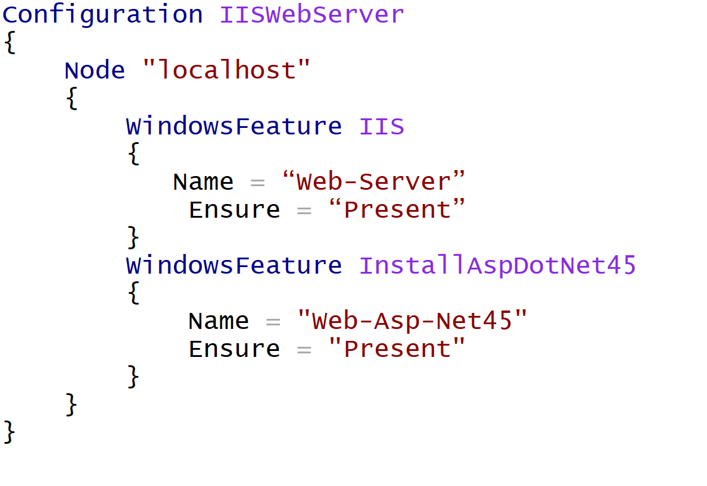
PowerShell DSC Script – Install IIS and ASP.Net

Slide 42
Azure Posh Deploy – Labs pt 6

Slide 43
Day 3

Slide 44

0 – 60 in 2 days

Slide 45
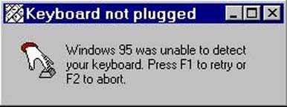
Retrospective

Slide 46
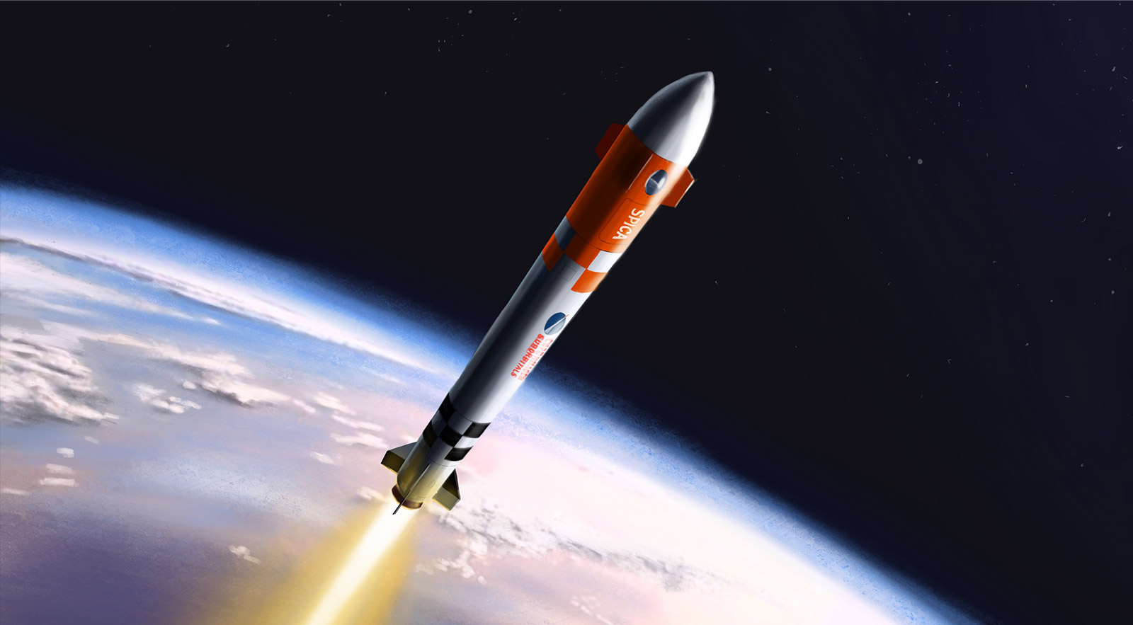
Fasten your seatbelts

Slide 47
Git & Visual Studio
Clone the repo
Stage (add) your code
Commit the code
Push your code
Pull code

Slide 48
CI/CD
Continuous Integration
Continuous Deployment
Continuous Delivery
Building a (build/release) pipeline…

